Slide 1
Annual Performance Report
Understanding the APR

Slide 2
APR Data Elements: Reports
The Annual Performance Report (APR) is a HUD Standard report which uses the most recent enrollment for active deduplicated clients during the report period (based on Start and End dates selected in the report parameters).
APR contains over 60 data elements:
Overall counts from latest project stay from report period
Specific data about Chronic Homelessness and Fleeing DV
Specific data about Stayers and Leavers
Data quality/missing data information

Slide 3

APR Data Elements
What You Will See
Report Name
Agency Name
Report Period Dates
CoC Category Filter
Client Location Filter

Slide 4
Question 4 a: Project Identifiers
Agency Name & HMIS ID
Program Name & HMIS ID
HMIS Project Type Code
RRH SubType
Coordinated Entry Access Point
For Services Only: affiliations with residential types
CoC
Geocode
HMIS software name
Report start and end date
Number of clients and household enrolled

Slide 5
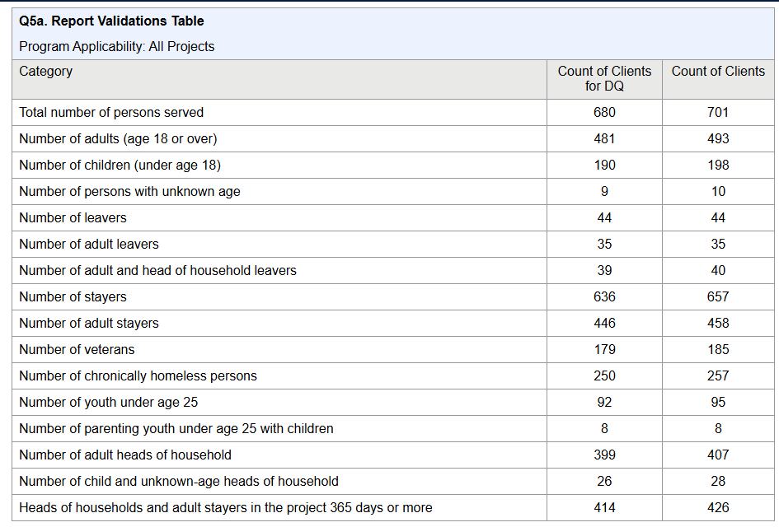
Question 5a: Report Validation Table
How many total clients did we serve, in which categories?
Provides a summary of the persons served.
Count of Clients
Counts all active clients for the report period.
Count of Clients for DQ
Counts active clients for the report period.
Will not count inactive clients.
Will not count clients that should not be evaluated for Data Quality (missing Date of Engagement)

Slide 6
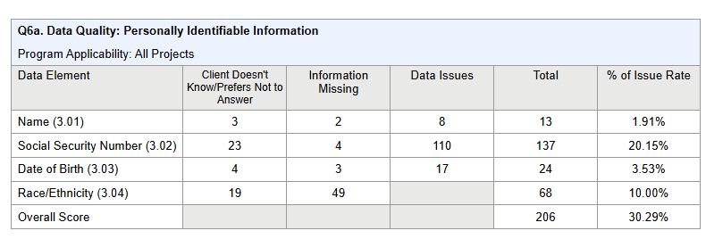
Question 6a: Data Quality Personally Identifiable Info.
How much PII and/or demographic data are we missing?
Client doesn't know/Refused
Information Missing: Data not Collected/Null/Blank
Data Issues:
Partial Name Quality Field
SSN less than 9 digits, “000”, etc
DOB partial, before 1915, after record created, etc

Slide 7
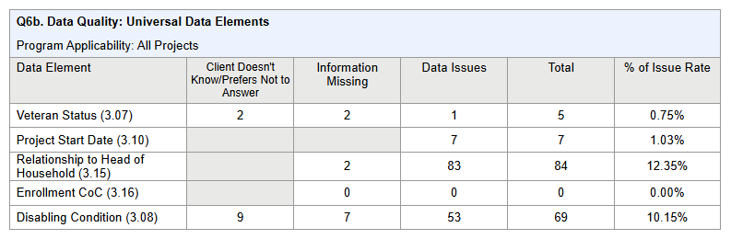
Question 6b: Universal Data Elements
What errors are showing for other Client Profile data?
Client doesn't know/Refused/Missing
Overlapping dates in same project
HoH data conflicts
Conflict where Disabling
Condition =No, but type of Condition =Yes

Slide 8
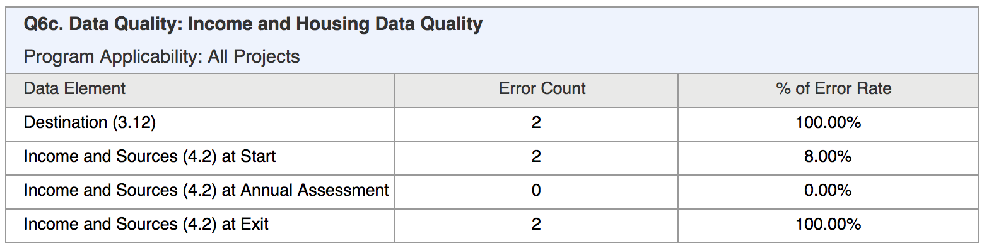
Question 6c: Income and Housing
What errors are showing for Income and Housing data?
Client doesn’t know/Refused/Missing
Exit Destination (Housing)
Mismatches between Yes/No and data entered for Income Source

Slide 9
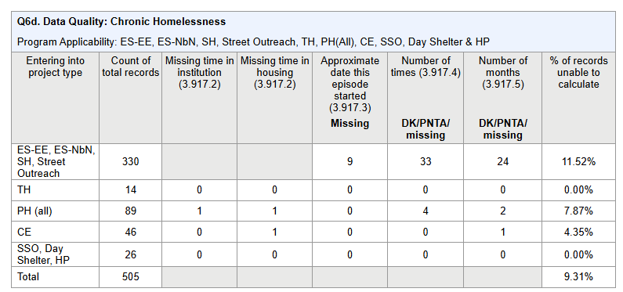
Question 6d: Chronic Homeless Data
Count of active adults/HoH who entered the project anytime after the reports start date
Count of enrollments that are missing certain fields for Living Situation questions
% of enrollments that cannot be used to calculate CH
Transfers from PH or TH will not be calculated towards this
Is anything missing that may be needed to identify a client as “chronically homeless?”

Slide 10
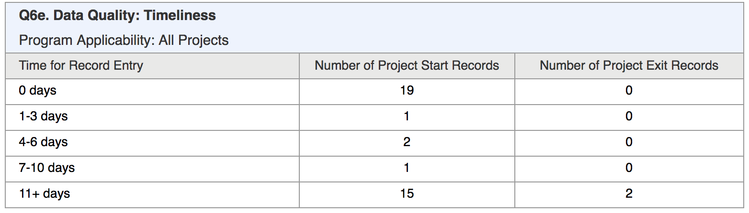
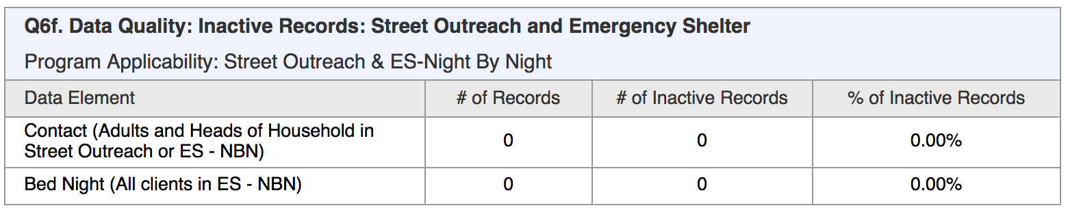
Questions 6e/6f: Timelines/Inactive Records
How long are we taking to enter enrollments and exits into the Clarity System?
Days between project start or exit date and the ONE timestamp
No Contact or Bed Night within 90 days since entry or last Contact/Bed Night
No Bed Night for more than 90 days (all members of household)
How many clients in our Street Outreach or NBN Shelter are being counted as inactive and need an update or an exit?

Slide 11
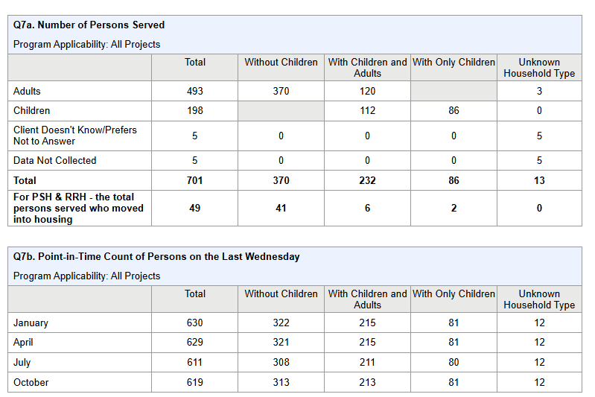
Questions 7a/7b: Persons Served
How many adults and children did we serve overall, and on the HUD PIT dates?
Count of individuals (vs. households)
Unknown household type is when none of the other categorizations can be determined
PIT date counts do not include Emergency Shelter or “Other” project types.

Slide 12
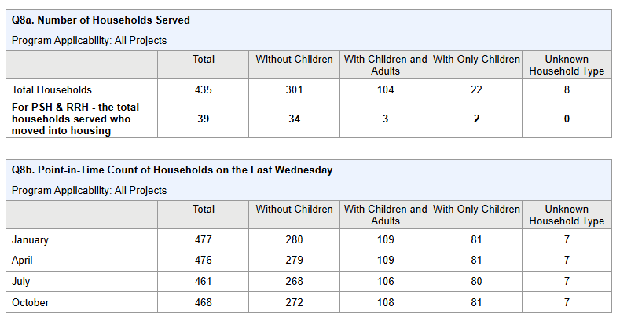
Questions 8a/8b: Households Served
Count of households (vs. individuals
Unknown Household type is when none of the other categorizations can be determined
PIT date counts include all project types
How many households did we serve overall, and on the HUD PIT dates?

Slide 13
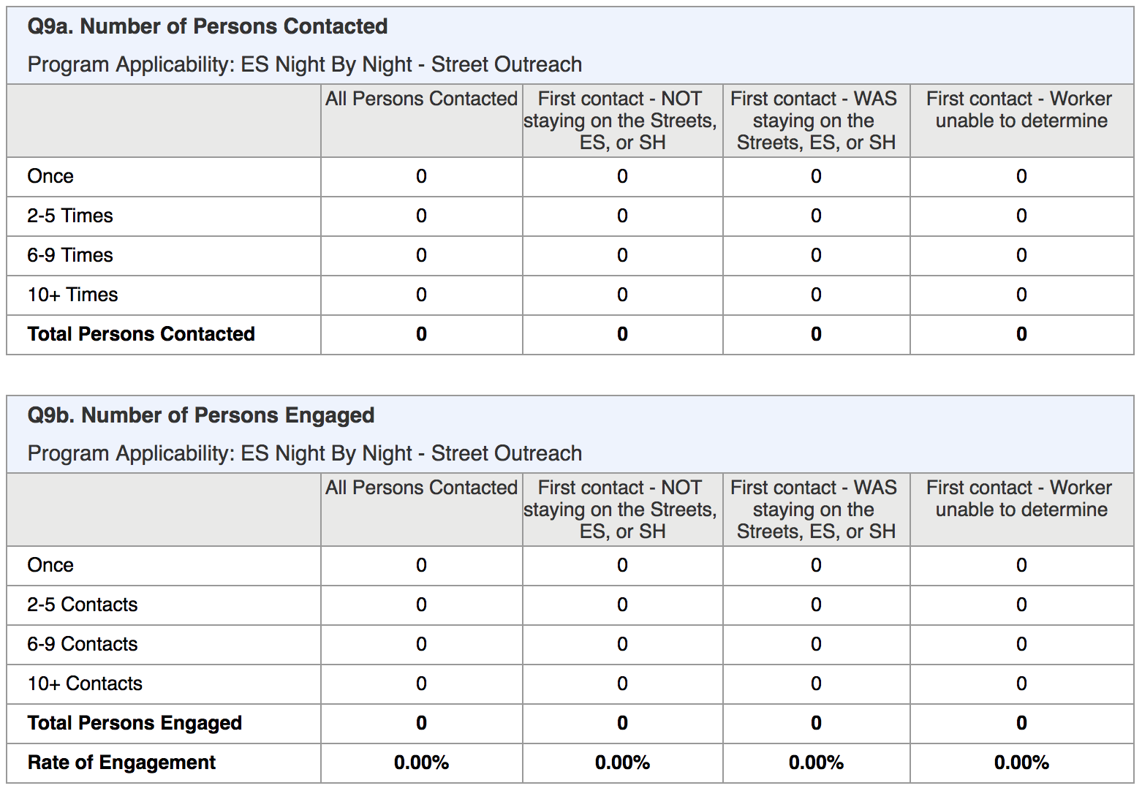
Questions 9a/9b: Contacted and Engaged
How many clients were we in contact with and what was their status as first contact?
Applies to Adults/HoH only
“Contacted” means contact service, bed night, or date of engagement (if no contact recorded) - from whole project stay
“First contact” is first contact within the report date range
Persons Engaged table shows contacts but only for clients who have an Engagement Date
Rate calculated by dividing Total Contacted (Q9a) / Total Engaged (Q9b)

Slide 14
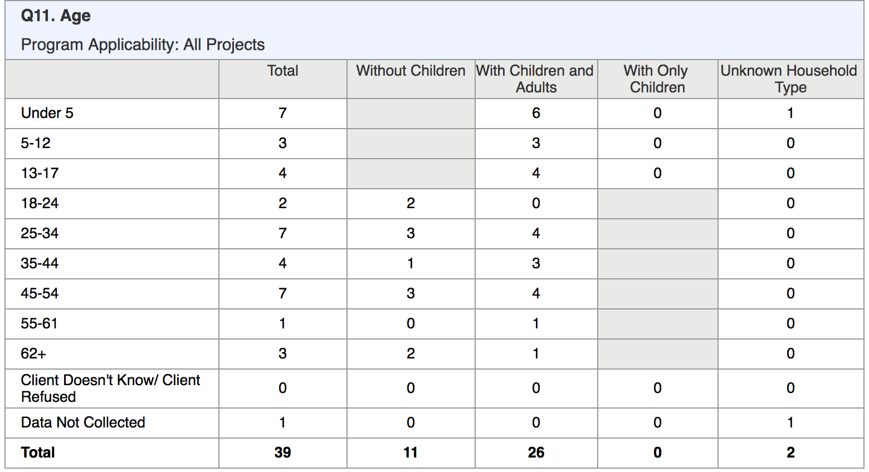
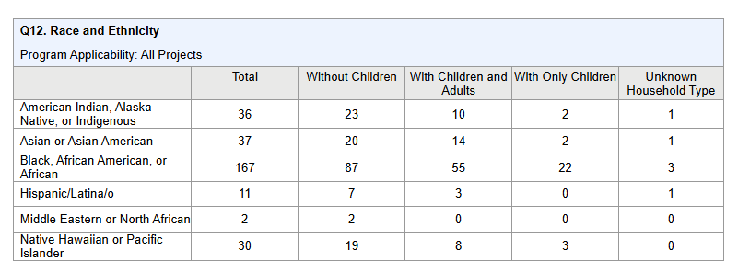
Questions 11/12: Age/Race and Ethnicity
Shows totals in each category (age, race, ethnicity)
Shows household types that make up the total (age, race, ethnicity)
Very young child-only households may be indicator of data quality issue (12a only)
Unknown Household Type is when none of the other categorizations can be determined (age, race, ethnicity)
What is the breakdown of our client population by age, race and ethnicity?

Slide 15
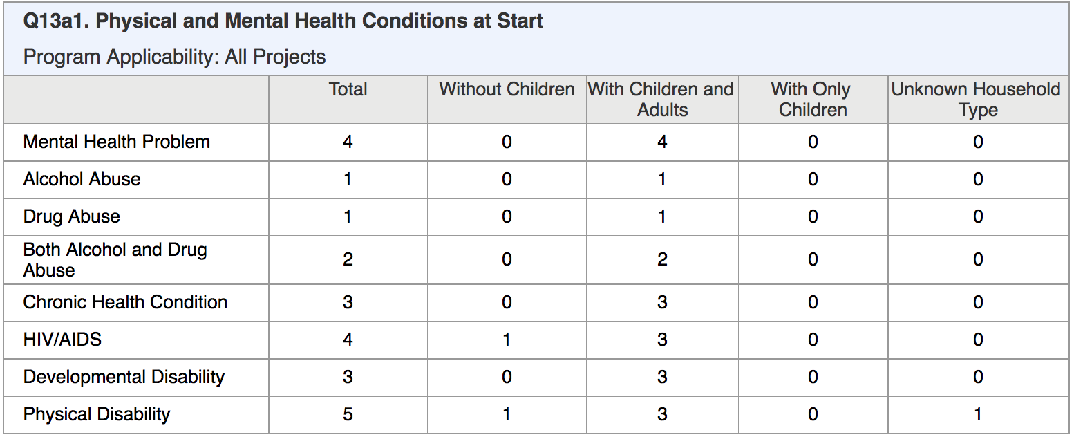
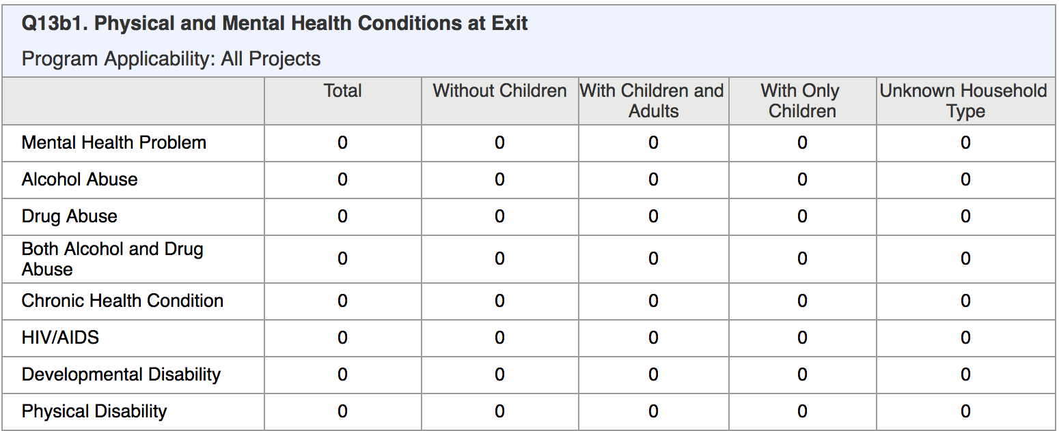
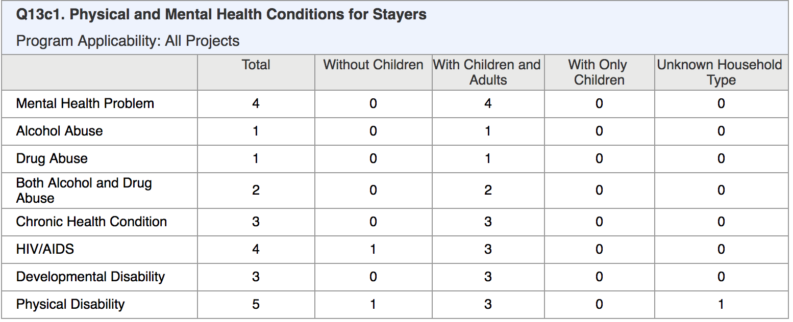
Questions 13a1/13b1/13c1: Condition Types
Shows totals in each condition category
Shows household types that make up the total
Shows HIV/AIDS total
Conditions for Stayers pulled from the most recent screen (i.e., status update screen if available)
What physical and mental health conditions did our clients have at project entry, project exit, or based on most recent information available if enrollment is still active?

Slide 16
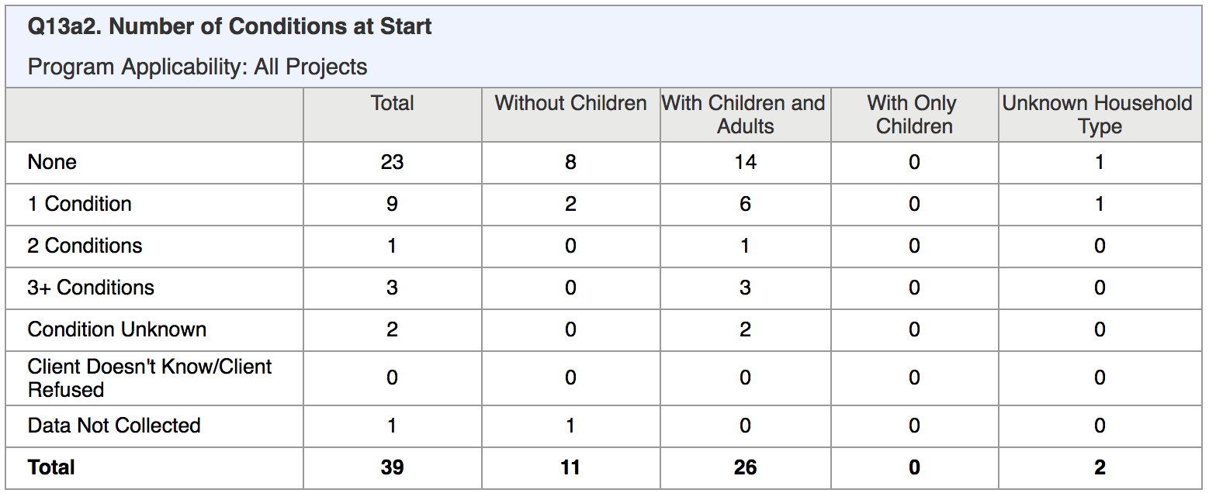
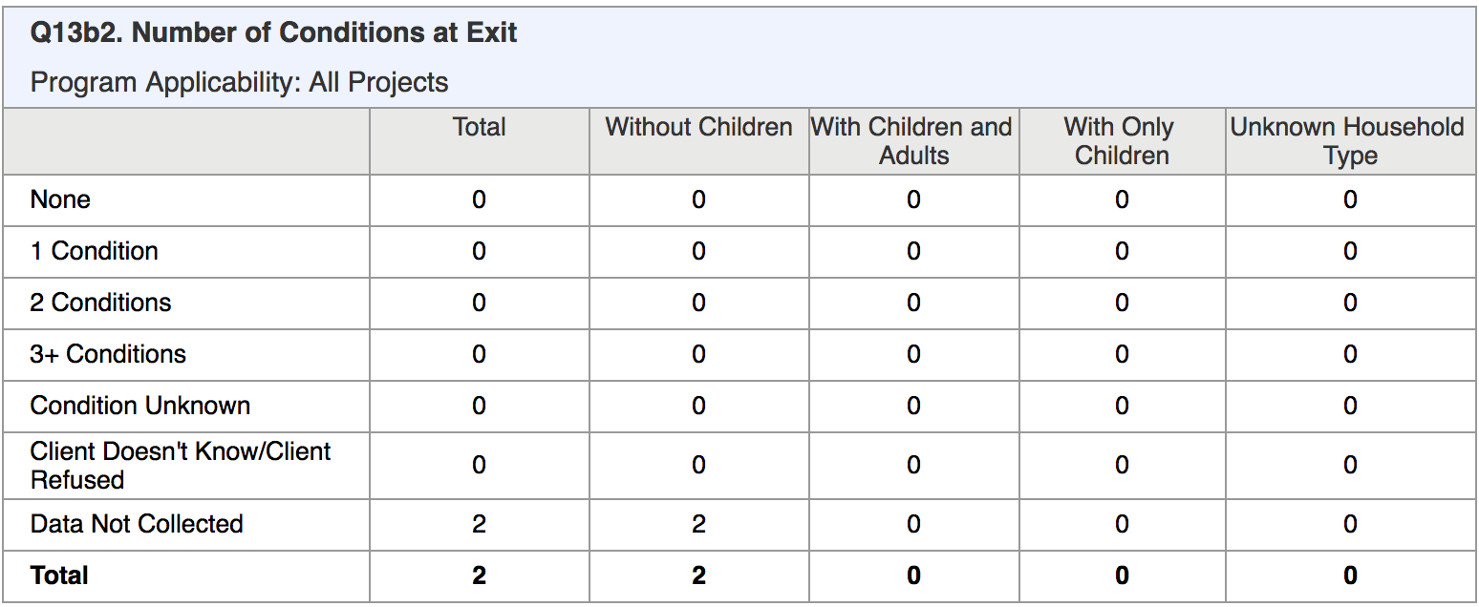
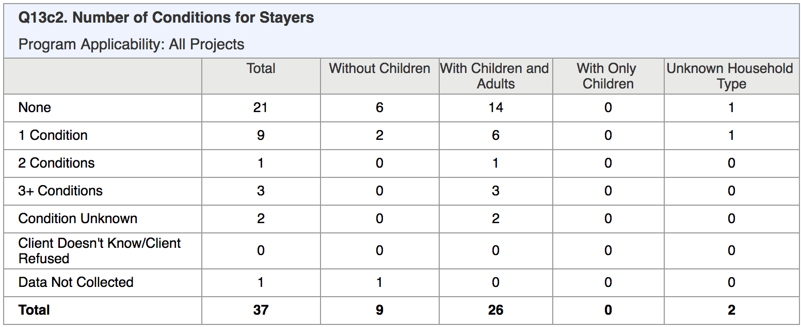
Questions 13a2/13b2/13c2: Count of Conditions
Shows totals in each count category
Shows household types that make up the total
Conditions for Stayers pulled from the most recent screen (i.e., status update screen if available)
How many conditions did each of our clients have at project entry, project exit, or based on most recent information available if enrollment still active?

Slide 17
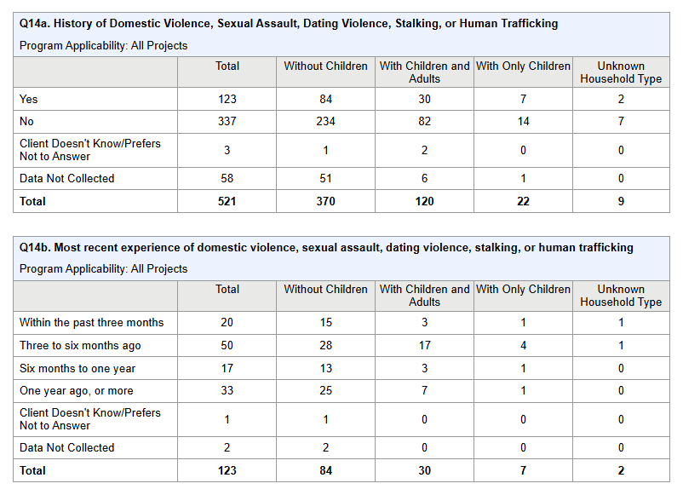
Questions 14a/14b: Domestic Violence History & Fleeing
Count of all Adults/HoH indicating survivor of domestic violence
Shows household types that make up the total
Count of all Adults/HoH with history of DV who were also fleeing at project entry
Shows household types that make up the total
How many of our clients reports a history of domestic violence?
How many of our clients are actively fleeing?

Slide 18
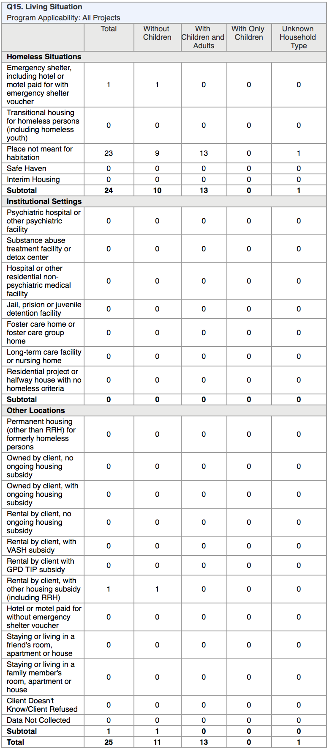
Question 15: Living Situation
What situations were our clients living in immediately prior to entering our project?
Count of all Adults/HoH within each category:
Homeless Situation
Institutional Setting
Other
Related to Chronic Homeless status
Shows household types that make up the total

Slide 19
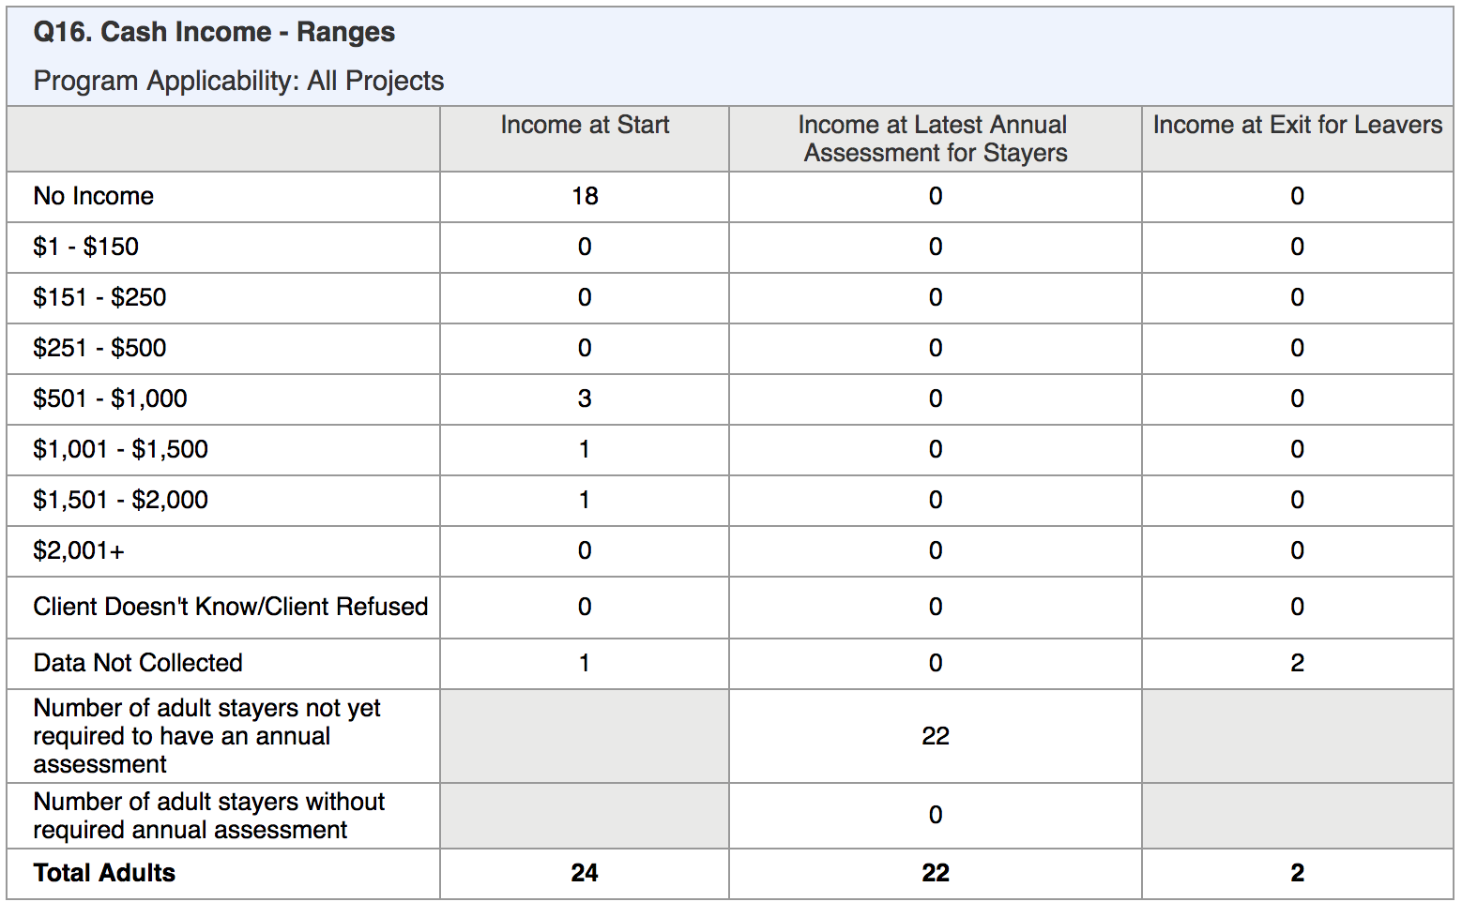
Question 16: Cash Income Ranges
How much monthly income were our adult clients receiving at project entry, exit, or as reported on their latest annual update in Clarity?
Count of all Adults within each category
Sum of column equals Total at bottom and matches counts on first Report Validation Table for
Adults
Adult Stayers
Adult Leavers
Stayers 365+

Slide 20
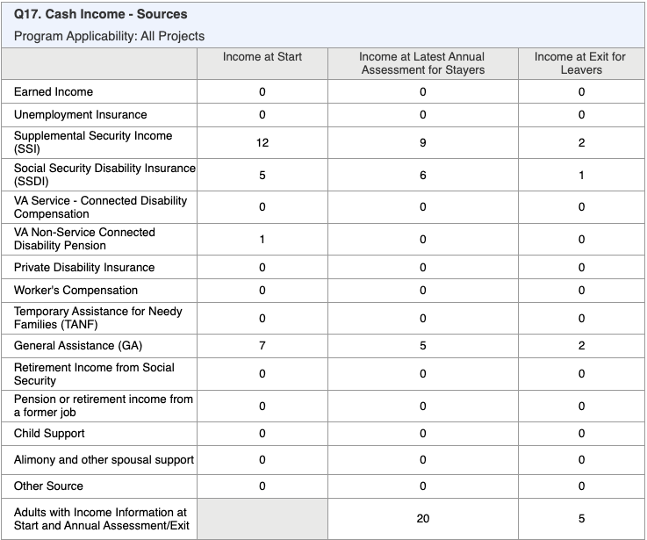
Question 17: Cash Income - Sources
Count of all Adults within each income source category at Start/Annual/Exit
Bottom row shows count of adults that had income sources throughout their entire stay (Start → Annual Assessment → Exit Income)

Slide 21
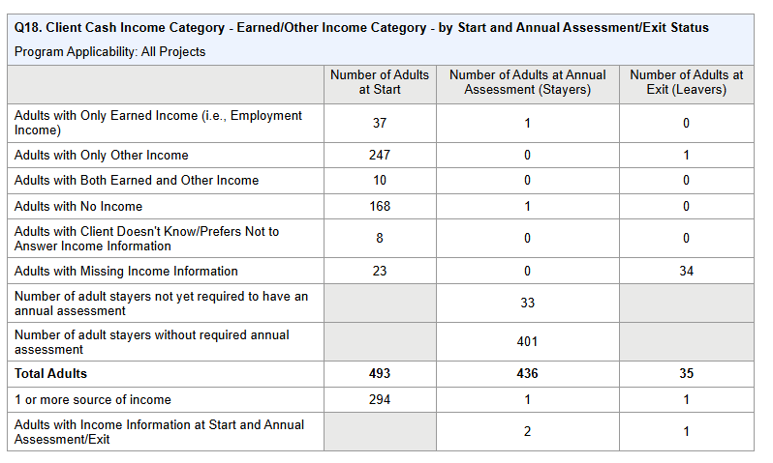
Question 18: Cash Income by Start/Annual/Exit
How many adult clients have “earned” vs. “other” type of income vs. none/missing?
Count of all Adults within each source category at Start/Annual/Exit
Bottom rows shows counts of adults that have more than one source to compare:
Start → Annual Update Income
Start → Exit Income

Slide 22
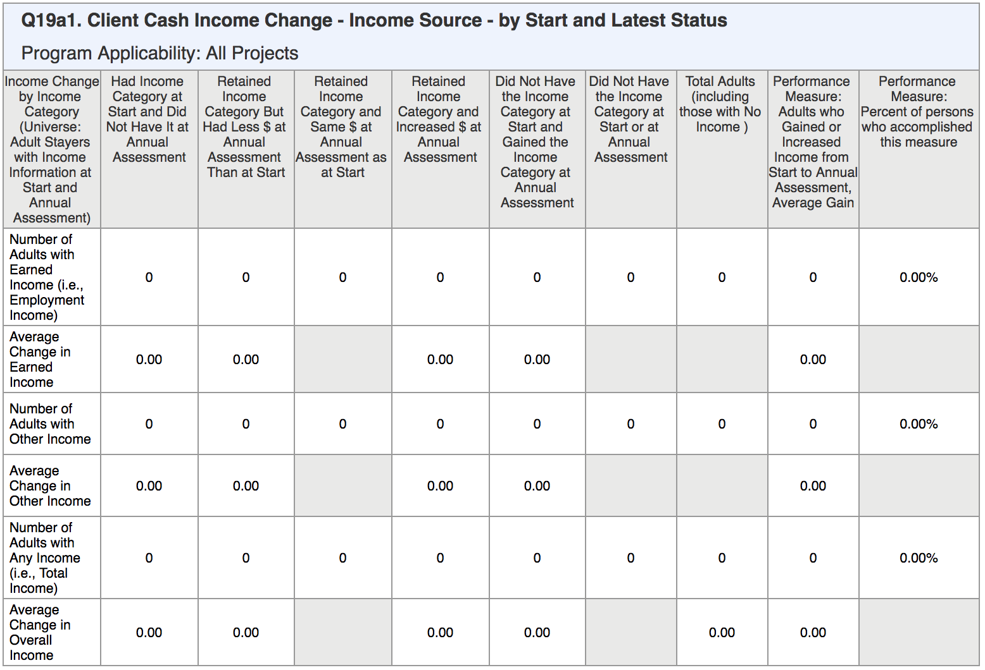
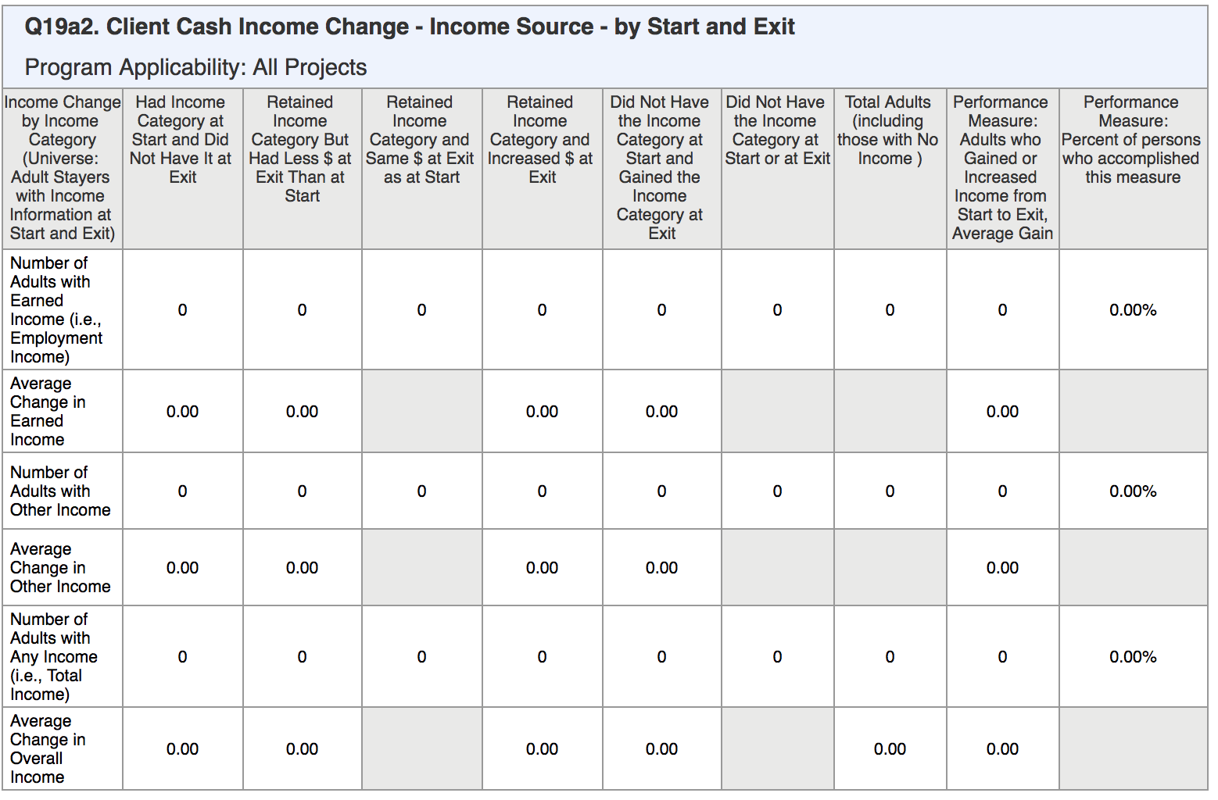
Questions 19a1/19a2: Income Change
Count of Adults with “earned” and “other” income in each category re: retention and type
Shows income changes between:
Start → Annual Update
Start → Exit
Start → Annual/Exit
Calculates the average change across the group of clients that fit the category
How many adult clients have had a change in income amount or type of income over time? How much has their income changed?

Slide 23
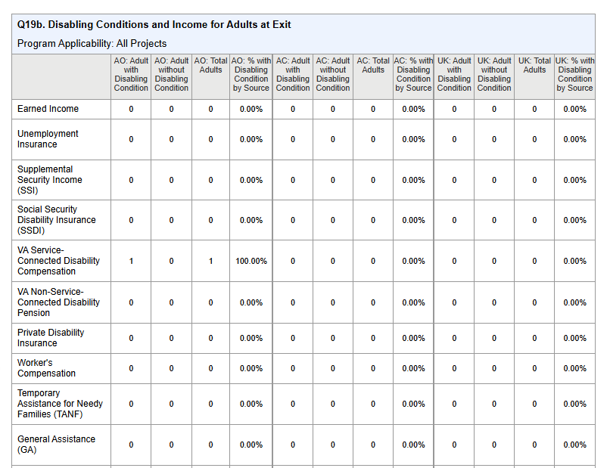
Questions 19b: Disabling Conditions and Income at Exit
Count of Adults with or without disabling conditions and their income source
Calculates the percentages across each group of clients that fit within the category

Slide 24
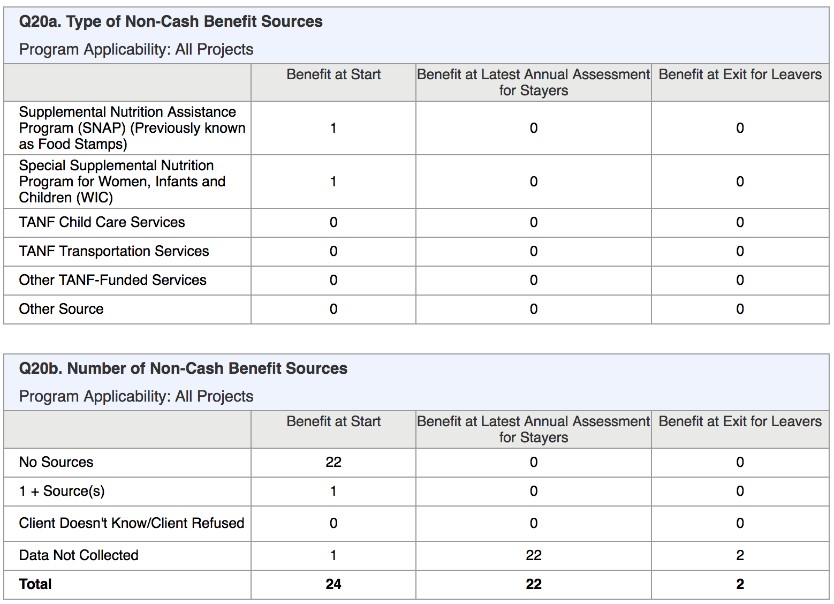
Questions 20a/20b: Non-Cash Benefit Sources
Count of Adults for each type of benefit and number of benefit sources
Separate counts at project entry, annual update, and exit
Leavers: HoH who left plus other adult household members who left at the same time
What types of non-cash benefits do our adult clients receive? How many non-cash benefits do our clients receive?

Slide 25
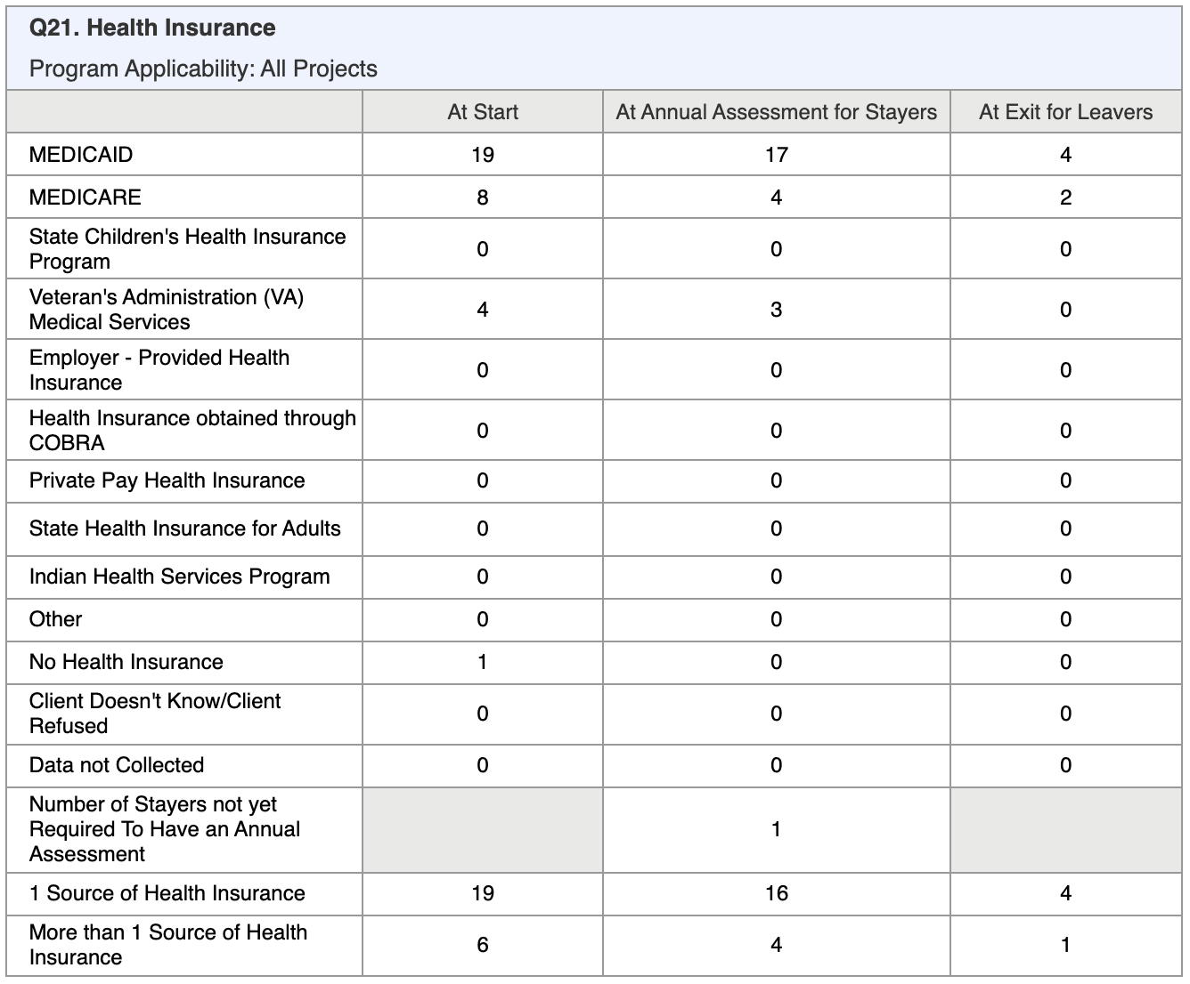
Question 21: Health Insurance
What type of health insurance do our clients have?
Count of all clients within each source category at Start/Annual/Exit
Bottom rows shows counts of clients who have only one source vs. more than one source at Start/Annual/Exit

Slide 26
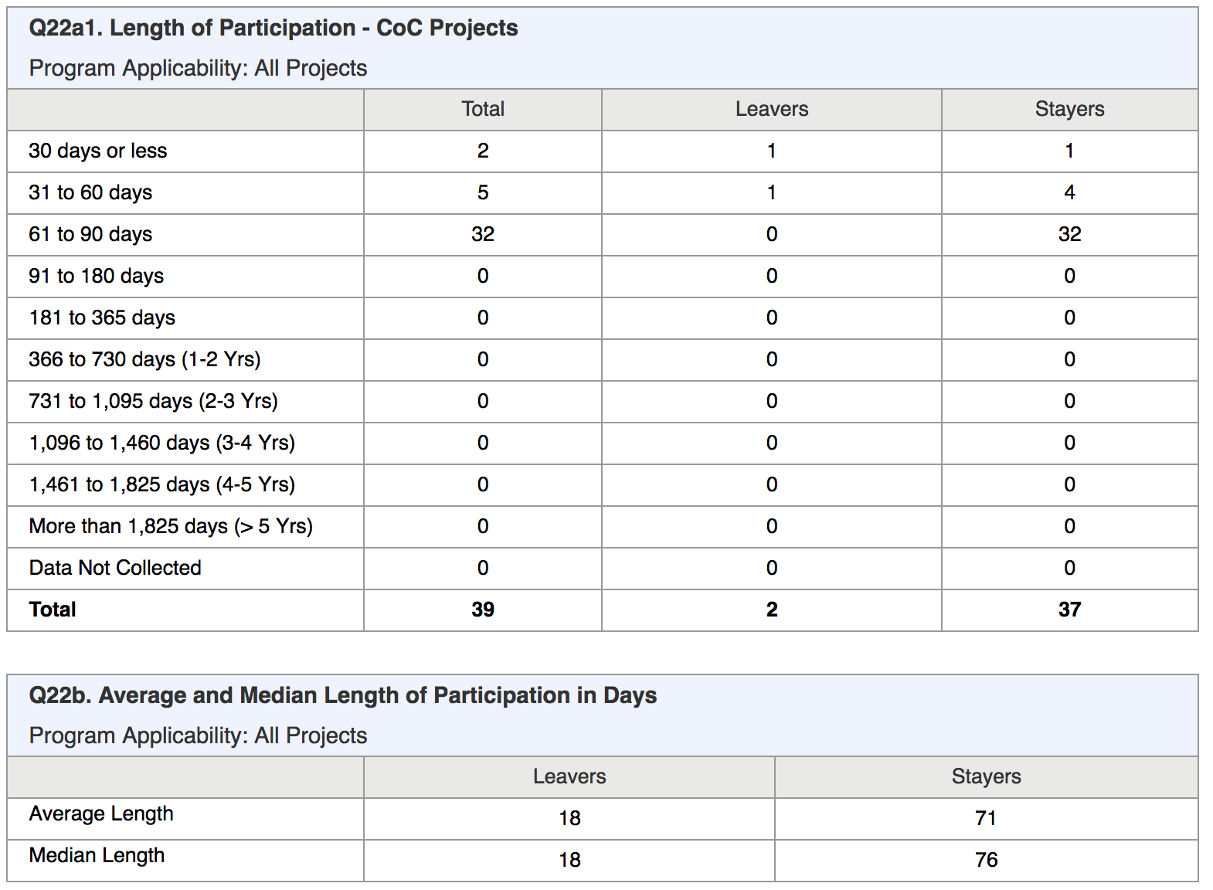
Questions 22a1/22b: Length of Participation
How long did our clients participate in our program?
What is the average number of days in our program for clients who exited vs. clients still participating?
Count of all clients active during report period, categorized by range of days
Shows ranges for Total/Leavers/Stayers
Includes full time in latest project stay, even if project entry before start of report start date

Slide 27
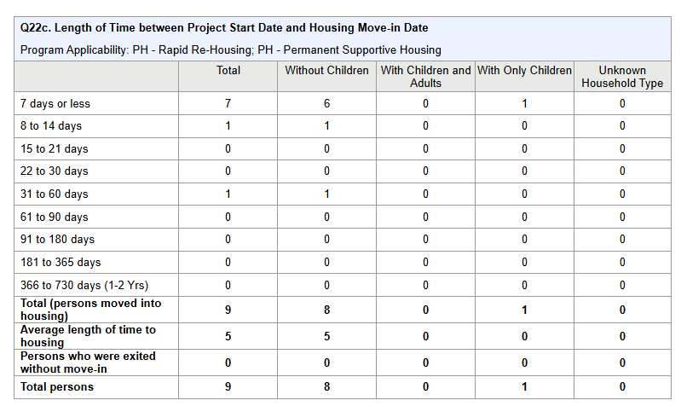
Question 22c: Length of Time Between Start & Move-In
How long between when our clients entered the program and the time the clients moved into housing?
Count of all clients active during report period, categorized by range of days between project start date and move-in date
Shows number of clients in each household type that make up the total

Slide 28
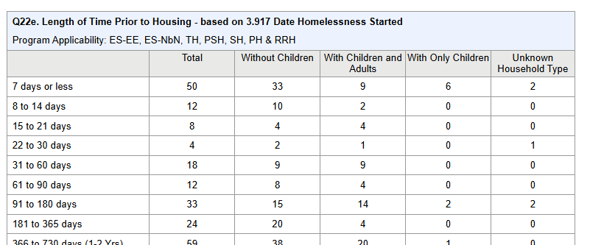
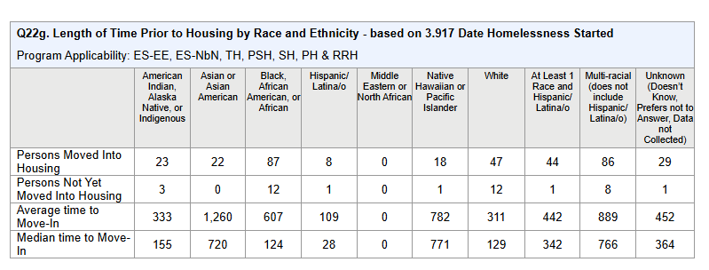
Question 22e /22g: Length of Time Prior to Housing
- based on 3.917 Date Homelessness Started
How long between when our clients become Homeless and the time the clients moved into housing?
Count of all clients active during report period, categorized by range of days between project start date and move-in date
Shows number of clients in each household type that make up the total

Slide 29
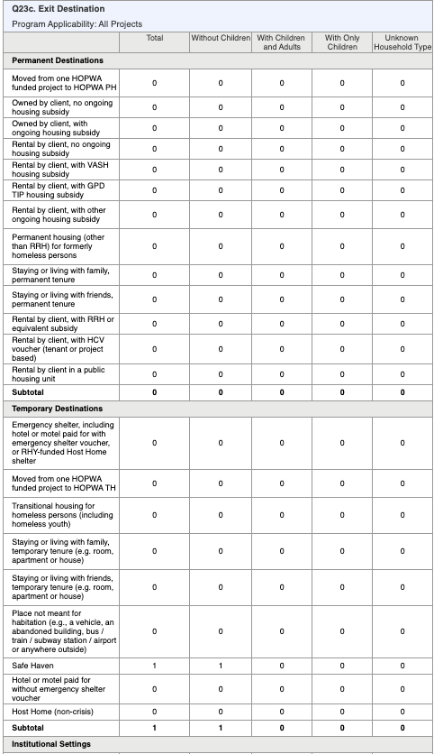
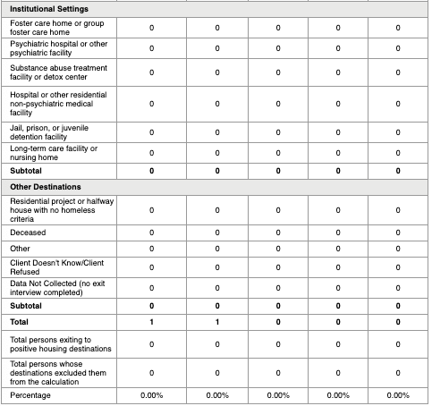
Question 23c: Exit Destination
Counts all clients with exit date in report range, including by each household type
Bottom rows include:
Total clients exiting to positive destination
% of clients exiting to positive destinations
“Positive destination” = permanent, with additional positive destinations to temp/institutions for Street Outreach projects
What were the exit destinations for our clients who were enrolled in our program for more than 90 days?

Slide 30
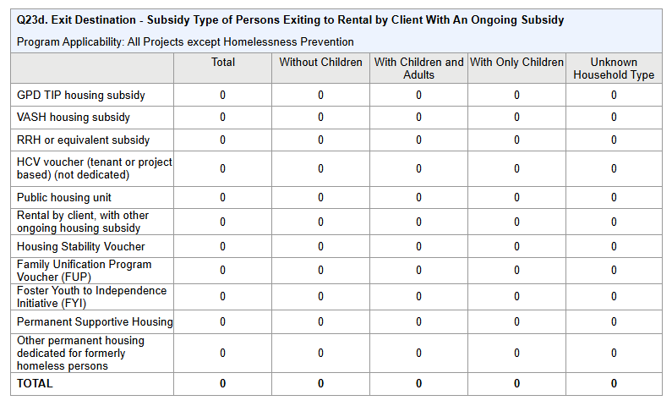
Question 23d: Exit Destination - Subsidy Type of Persons
Exiting to Rental by Client With An Ongoing Subsidy
Summarizes the rental subsidy types reported by persons who have exited during the report period.
Broken down by household type.

Slide 31
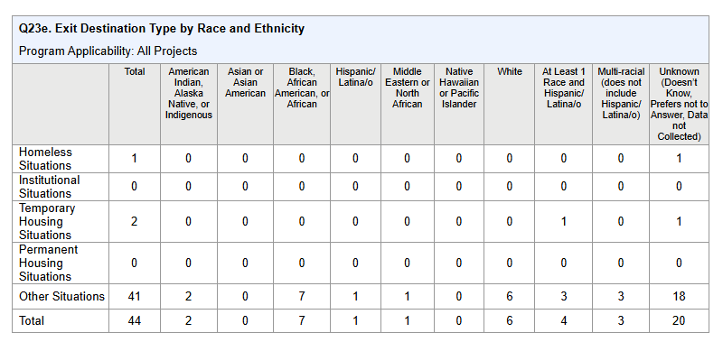
Question Q23e. Exit Destination Type by Race and Ethnicity
Total number of persons exited by HUD categories for living situation (Homeless, Institutional, Temporary, Permanent, Other) and race/ethnicity.

Slide 32
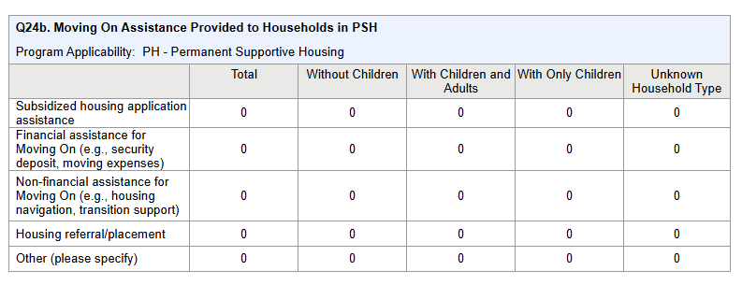
Question Q24b. Moving On Assistance Provided to
Households in PSH
Q24b – Moving On Assistance Provided to Households in PSH
▪ Summarizes the types of Move On
Assistance persons have
received in the report period.
▪ Broken down by household type.

Slide 33
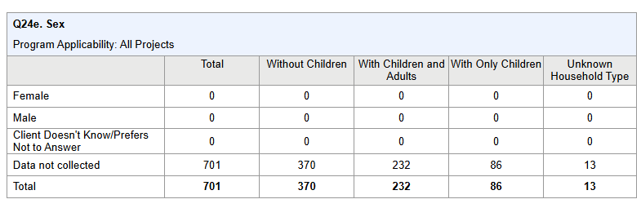
Q24e. Sex
Q24e – Sex
▪ Reports adults in All projects by sex.
▪ Broken down by household type.

Slide 34
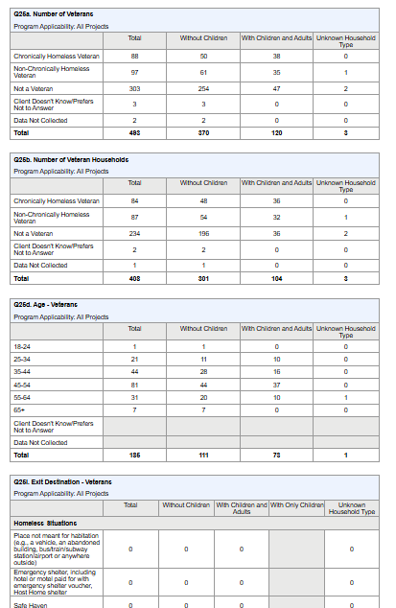
Question 25 (a,b,d,I,j): Veterans
Question 25 (a,b,d,I,j) is similar to previous data elements, but with a focus on veterans. Elements include:
Age
Physical and Mental Health Conditions,
Cash Income at Program Start and Annual Assessment
Type of Cash Income Sources
Types of Non-Cash Benefits Sources
Exit Destination
Notes:
Question 25(a-i) are similar to previous data elements, but with a focus on Veterans and Veteran Households:
Veterans: a client is counted as a Veteran when the client is an adult (age 18+) and when Veteran Status = Yes
Veteran Households: a household is considered a Veteran Household when any of the adults in the household has Veteran Status = Yes (for HoH’s latest project stay in report range)
Elements include:
Counts of Chronically Homeless Veterans and CH Vet Households Age, Conditions, Cash Income Type/Change, Benefits Type/Change, and Exit Destination

Slide 35
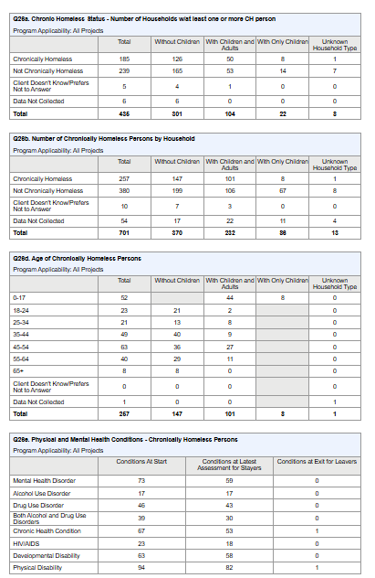
Question 26 (a-h): Chronically Homeless individuals
Question 26 (a-h) is similar to previous data elements, but with a focus on chronically homeless individuals. Elements include:
Number of Households w/at least one or more CH person
Number of Chronically Homeless Persons by Household
Age
Physical and Mental Health Conditions,
Cash Income at Program Start and Annual Assessment
Type of Cash Income Sources
Types of Non-Cash Benefits Sources
Exit Destination
Notes:
Question 26 (a-h) is similar to previous data elements, but with a focus on Chronically Homeless (CH) Clients and Households
CH Households determined based on whether any of the adults or heads of household are chronically homeless at project start.
Elements include:
Counts of CH Household and CH Clients per Household
Age, Conditions, Cash Income Type/Change, Benefits Type/Change, and Exit Destination

Slide 36
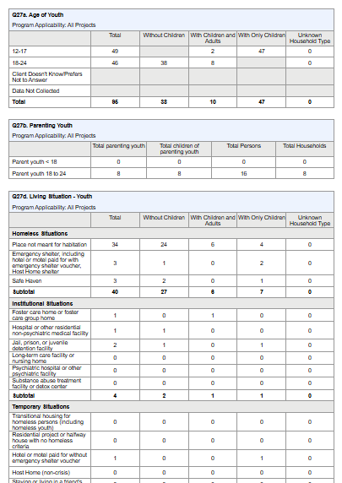
Question 27: Youth
How many young parents as HoH did we serve? How many of our clients are the children of those young parents?
Question 27 (a-e) is similar to previous data elements, but with a focus on Youth (12-24yrs). Elements include: Age, Parenting Status, Living Situation, Length of Participation (number of days in program), and Exit Destination
Count of HoH/Adults below 25 yrs and the count of children
Shows Total clients and total households
Total Parenting Youth includes count of any other adults that are in the household

