Slide 1
Coordinated Entry Policy Review
April 8, 2026
Notes:
Intent to present this month, offer time for feedback/questions and vote to adopt in May
Reviewed annually in accordance with HUD guidance, updated as needed
Discussions throughout: Anything need more clarity? Feedback/recommendations.

Slide 2
Coordinated Entry Policies
Grievance Policy
Grievance Policy User Guide
Housing Problem Solving Policy
Policies for Review

Slide 3
Coordinated Entry Policies

Slide 4
Coordinated Entry (CE) Policies
The CE policies cover an overview of Coordinated Entry as well as all key elements of the process:
Access
Assessment and Prioritization
Queues and Queue Management
Matching
Referral
Training
Data and Evaluation
Grievances and Complaint Tracking

Slide 5
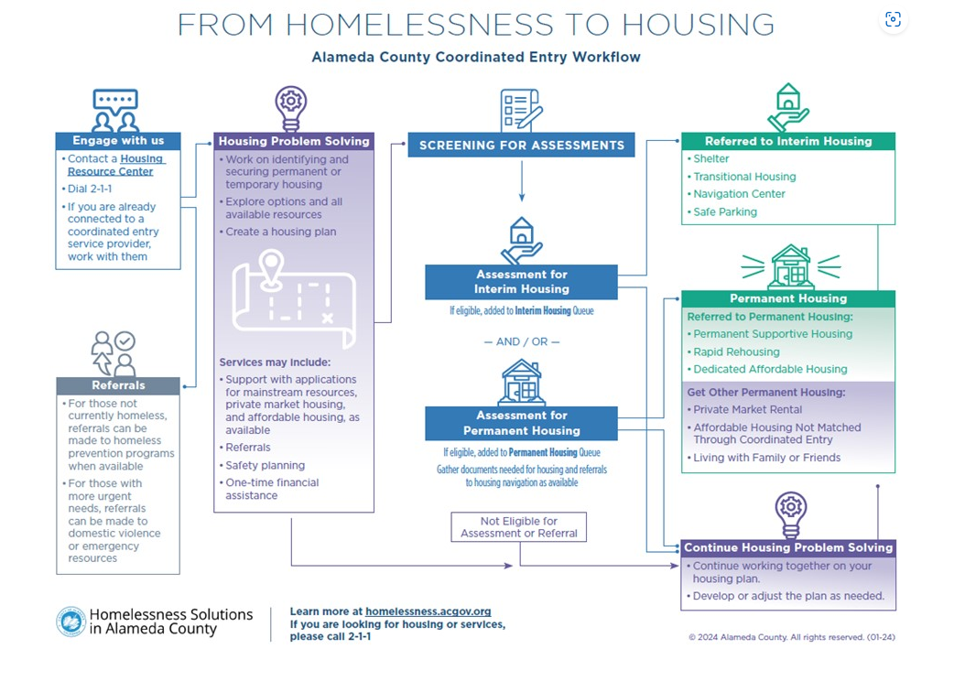

Slide 6
CE Policies
Proposed Updates:
5.7- Matching for Navigation Services
Remove: “(such as EHV)” as this is no longer an available resource
Notes:
Context for why not now (recently wrapped eval, actively making changes, etc.) and compliance timing is now. Several slides to follow with future opportunities identified.

Slide 7
CE Policies
Future opportunities:
Gender Based Violence (GBV) Access Points and comparable databases are now active. Policy updates may be needed:
1.6.3 Comparable Database
2.3.2 Access Points for Survivors of GBV
3.9 Workflow for Access Points for Survivors of GBV & “Coordinated Entry Workflow for GBV Access Points”
4.7 Queue Management for GBV Access Points
5.8 Matching for Survivors of GBV
6.5 Referral for Survivors of GBV
7.1.1 Training for GBV Access Points

Slide 8
CE Policies
Future opportunities:
H&H has a new interim housing team that is considering best practices for matching to interim resources (that fall within the CoC). Policy updates may be needed:
3.7 Crisis Assessment
4.2 Crisis Queue
4.6.1 Removal from the Crisis Queue
5.1.1 Regional Matching
5.2 Matching for Crisis Resources
6.3 Matching and Referral for Crisis Resources

Slide 9
CE Policies
Future opportunities:
2.3 Access Points for Designated Subpopulations
Revisions may be needed depending on sub- populations identified through new HRC contracts
2.4 Weekend and Evening Access
Update to align with new HRC contract requirements on/after July 1
3.2.1 Steps in [HMIS] Workflow
Elements of the flow of documentation in HMIS may be changing in response to CE Evaluation recommendations

Slide 10
CE Policies
Future opportunities:
6.4 Matching and Referral to Permanent Housing Resources
Conversations in process between H&H and cohort of housing developers in terms of potential changes to referral policies
7 Training
New training guidance will be needed as a part of new HRC contract requirements on/after July 1

Slide 11
CE Grievance Policy

Slide 12
Grievance Policy
Proposed Update:
p.3- Procedure
Add: If the participant or potential participant has a CE related grievance directly with H&H, steps 5.1-5.3 can be skipped and the grievance can be sent to H&H by phone, mail, or email.
Future opportunities:
Alignment with proposed recommendations that surface through larger CoC discussions around grievances

Slide 13
Grievance Policy: User Guide
Developed in March 2024 in response to frequently asked questions about the CE grievance policy.
This document does not require OAC approval, but has been brought back annually for committee awareness and feedback.

Slide 14
Housing Problem Solving Policy

Slide 15
Housing Problem Solving (HPS) Policy
Outlines system-level policies related to the purpose, intent, timing, delivery, uses of flexible funds, and key outcomes of Housing Problem Solving (HPS) in Alameda County.
Intended to guide the work of all organizations delivering HPS services and the use of HPS resources within the system, regardless of originating funding source, geographic area, location delivered, or population served.
NOT a training manual or a best practice guide. Training materials and guidance on employing best practices in delivering HPS are provided separately.

Slide 16
Housing Problem Solving (HPS) Policy
Proposed Updates:
p. 11- Rental Payments and Deposits /Other Flexible Assistance
Change from “Three (3) times Fair Market Rent” to “Two (2)” to align with changes in CA legislation
Change from “Zone Coordinator” to “County staff overseeing the contract”
p. 12- Approval Process and Documentation
Remove “who use HMIS”
Add “or comparable database if required under VAWA”

Slide 17
Housing Problem Solving (HPS) Policy
Future opportunities:
Visual look of HPS process graphic (p.6)
Expand guidance for those “at imminent risk” of homelessness as new prevention resources are added (p. 7)
Adjustments to “eviction prevention assistance” section (p.10) as new prevention resources are added (p. 10)
Flex Fund policies, to align with HRC changes on/after July 1 (p. 11)

